Slide 1
Continuous State-Space Models for Optimal Sepsis Treatment - a Deep Reinforcement Learning Approach
By Aniruddh Raghu, Matthieu Komorowski, Leo Anthony Celi, Peter Szolovits, Marzyeh Ghassemi
MIT University
Presentation by Kevin Gunn
May 23rd, 2017

Slide 2
Introduction
Sepsis is a leading cause of mortality in ICUs.
Individual patients respond very differently to medical interventions.
Accounts for 13.6% of in-hospital mortality in MIMIC-III.

Slide 3
Treatments
Antibiotics and infection source control.
IV fluids to correct for hypovolemia.
Vasopressors to counteract sepsis-induced vasodilation.

Slide 4
Goals
Find optimal sepsis treatment with deep reinforcement learning to reduce rate of in-hospital mortality.
Specifically - find the best amount and type of fluids, timing and dosing of vasopressors, the optimal antibiotic, and the use of corticosteroids.
Investigate the learned policies for clinical interpretability and potential use as a clinical decision support tool.

Slide 5
Reinforcement Learning – Notes (Don’t Include)
Models time-varying state spaces with a MDP.
At timestep t, an agent observes the current state s_{t}, takes an action a_{t} , receives reward r_{t}, and then transitions to new state s_{(t+1)}.
The agent selects actions at each timestep that maximizes its expected discounted future reward.

Slide 6
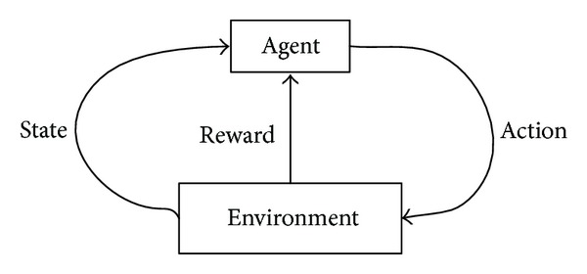
Reinforcement Learning

Slide 7
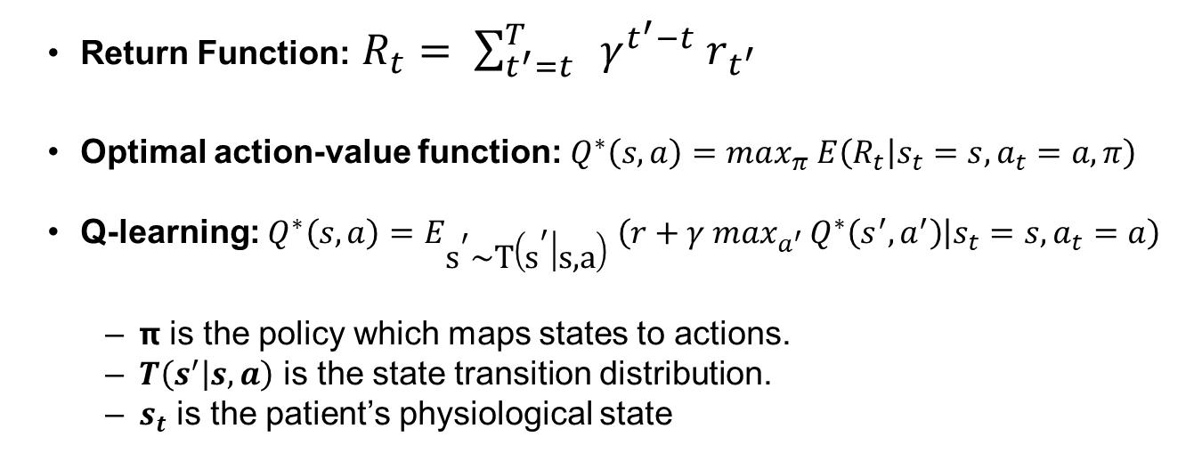
Reinforcement Learning
Return Function: $R_{t}= \sum_{t^{′}=t}^{T}{{ γ}^{t^{′}−t}{ r}_{t^{′}}}$
Optimal action-value function: $Q^{∗}\left(s,a\right)=max_{π} E\left(R_{t} | s_{t}=s,a_{t}=a,π\right)$
Q-learning: $Q^{∗}\left(s,a\right)=$ $E_{{\text{s}}^{\text{′}}\text{\sim }\text{T}\left({\text{s}}^{\text{′}} | \text{s}\text{,}\text{a}\right)} \left(r+γ max_{a^{′ }}Q^{∗}\left(s^{′},a^{′}\right) | s_{t}=s,a_{t}=a\right)$
𝝿 is the policy which maps states to actions.
$T\left(s^{′} | s,a\right)$ is the state transition distribution.
$s_{t}$ is the patient’s physiological state

Slide 8
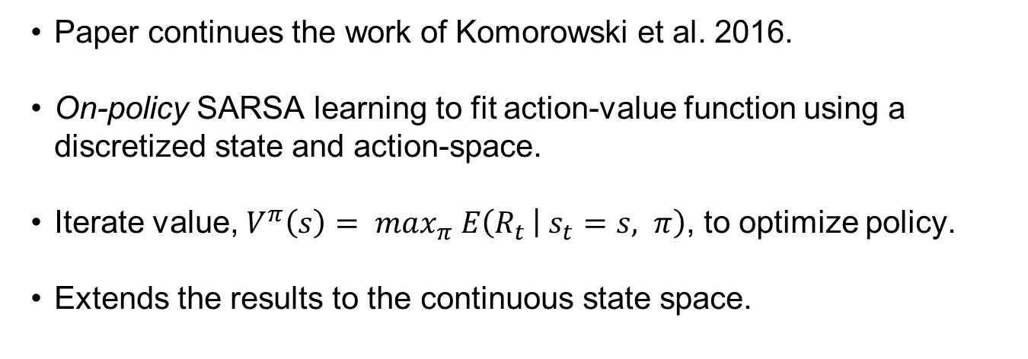
Previous Work
Paper continues the work of Komorowski et al. 2016.
On-policy SARSA learning to fit action-value function using a discretized state and action-space.
Iterate value, $V^{π}\left(s\right)= max_{π} E\left(R_{t } | s_{t}=s, π\right)$, to optimize policy.
Extends the results to the continuous state space.

Slide 9
Deep Q-Networks
DQNs combine reinforcement learning with a deep neural network.
multi-layered neural network that for a given state s outputs a vector of action values Q(s,a;θ), where θ are the parameters of the network.
off-policy
experience replay

Slide 10
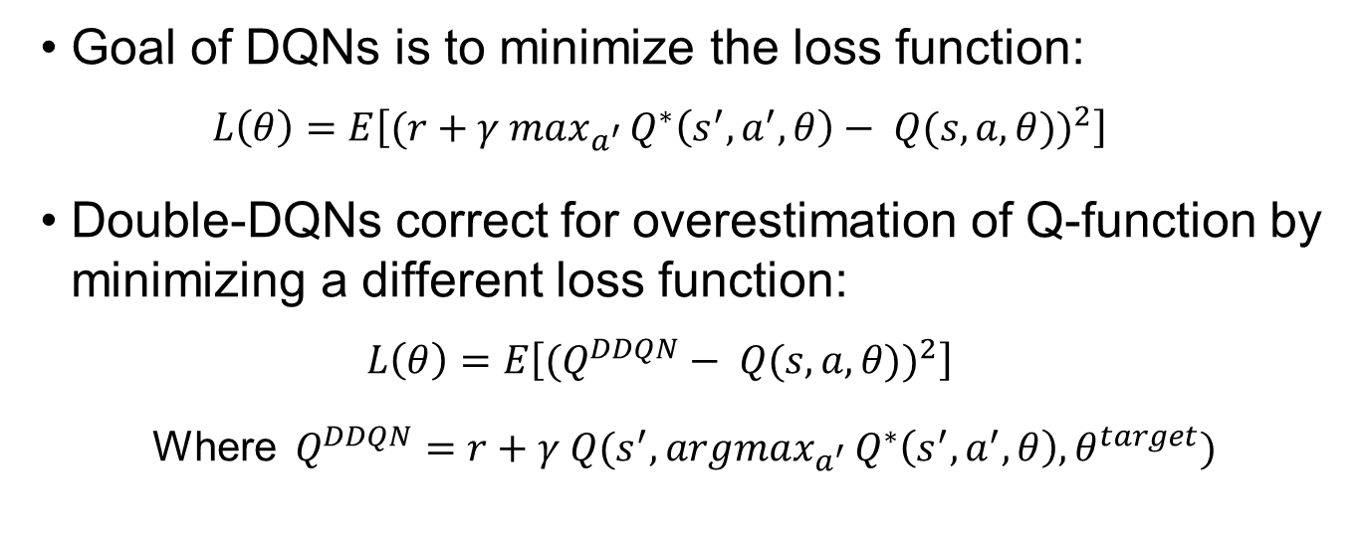
Deep Q-Networks
Goal of DQNs is to minimize the loss function:
$$L\left(θ\right)=E\left[{(r+γ max_{a^{′ }}Q^{∗}\left(s^{′},a^{′},θ\right)− Q(s,a,θ))}^{2}\right]$$
Double-DQNs correct for overestimation of Q-function by minimizing a different loss function:
$$L\left(θ\right)=E\left[{(Q^{DDQN}− Q(s,a,θ))}^{2}\right]$$
Where $Q^{DDQN}=r+γ Q(s^{′},argmax_{a^{′ }}Q^{∗}\left(s^{′},a^{′},θ\right),θ^{target})$

Slide 11
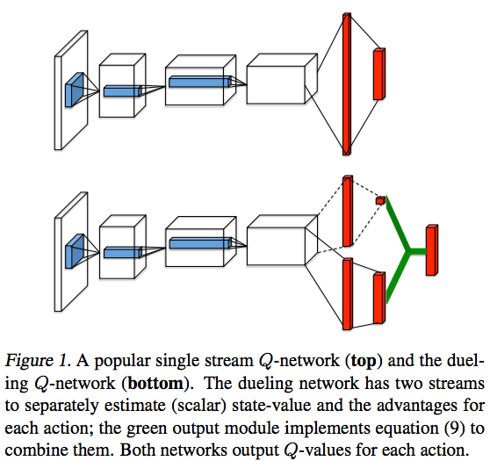

Slide 12
MIMIC-III
Contains data on forty thousand adult patients who stayed in critical care units of the Beth Israel Deaconess Medical Center between 2001 and 2012.
Includes information such as
demographics
vital sign measurements (~1 data point per hour)
laboratory test results
procedures
medications
caregiver notes, imaging reports
mortality (both in and out of hospital).

Slide 13
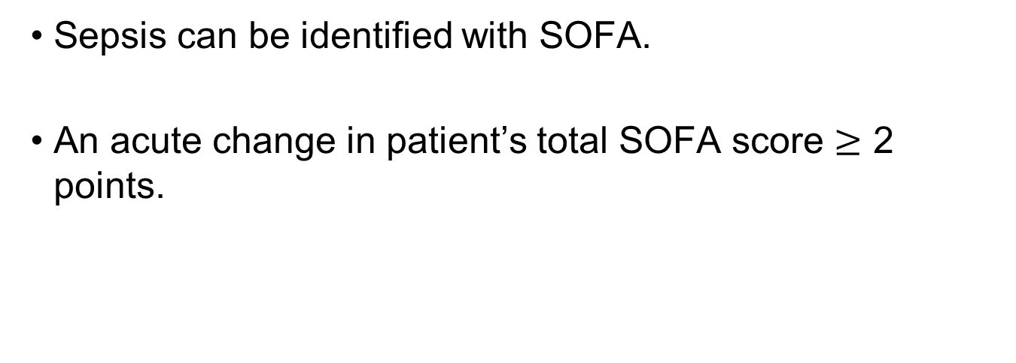
MIMIC-III
Sepsis can be identified with SOFA.
An acute change in patient’s total SOFA score $≥$ 2 points.

Slide 14
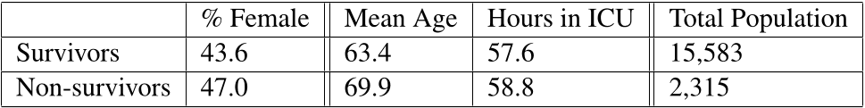
Cohort
Table 1: Comparison of cohort statistics for subjects that fulfilled the Sepsis-3 criteria.

Slide 15
Feature Preprocessing
Incorporated demographics, lab values, vital signs, and intake/output events.
Aggregated data into 4 hour windows.
Variables with excessive missingness were removed.
Values exceeding clinical limits were capped, and capped data was normalized per feature.

Slide 16
Action Discretization
5 × 5 action space covering the space of intravenous (IV) fluid (volume adjusted for fluid tonicity) and maximum vasopressor (VP) dosage in a given 4 hour window.
Discretized the action space into per-drug quartiles based on all non-zero dosages of the two drugs.
Converted each drug at every timestep into an integer representing its quartile bin.

Slide 17
Evaluation
Doubly Robust Off-policy Value Evaluation (Jiang and Li, 2015).

Slide 18
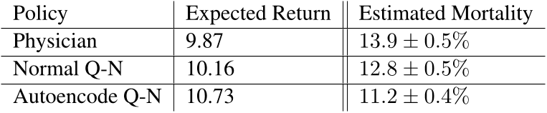
Results

Slide 19
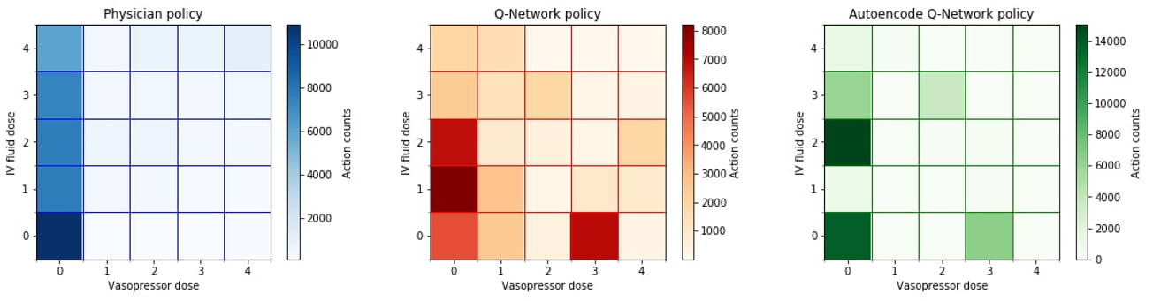

Slide 20
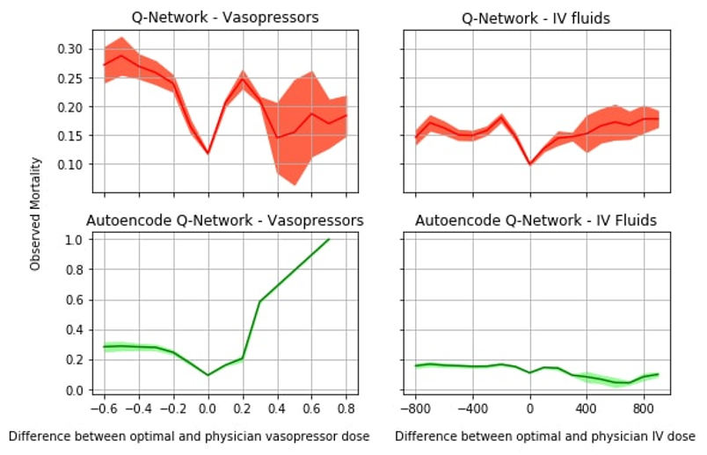

Slide 21
Conclusion
Explored applying deep RL to the problem of deducing optimal medical treatments for patients with sepsis.
Possible areas of improvement.
Credit assignment in this model is sparse. (rewards/penalties only being issued at terminal states)
Clinically informed reward function.

